Slide 1
Hierarchical Task Networks
More plans

Slide 2
Search Problem
We have looked at GOAP planning
Uses graph search
But graph search is slow
All nodes have to be searched
Pruning the search is hard
Not great for real time processing
There are other ways

Slide 3
Tree Search
Tree data structure
Used by decision trees and behaviour trees
Search can be fast as entire branches can be pruned
E.g. decision tree prunes subtrees every time a decision is made
Means search only continues down productive paths
Tree search can also be applied to planning
Planning can be thought of as a hierarchical structure
High level actions at the top
Each high level action consists of several lower level actions
Search the tree for a sequence of lower level actions which can be performed

Slide 4
Hierarchical Task Networks (HTNs)
Tree based planning architecture
Works more like the way humans plan
Only consider high level tasks/actions first
E.g. go to airport
If that task can be performed
Only then consider what sub-tasks we need to perform to perform the high level task
E.g. get the bus or get a taxi
If high level action cannot be performed
Don’t consider any of the sub-tasks

Slide 5
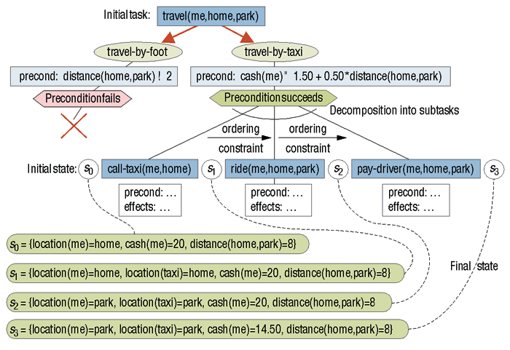
HTN Example
https://www.computer.org/csdl/mags/ex/2005/02/x2034-abs.html

Slide 6
High Level Tasks and Primitives
Two types of tasks
High level tasks
Also sometimes called compound tasks
Where the hierarchical aspect comes from
Cannot themselves be performed
Always decompose into a set of methods
Set of preconditions and sub-tasks, high level or primitive
Can be thought of as different ways to accomplish the task
Primitive tasks, effectively the same as actions
Sometimes called operators
Can be performed
Lowest level of task
Does not decompose into simpler tasks

Slide 7
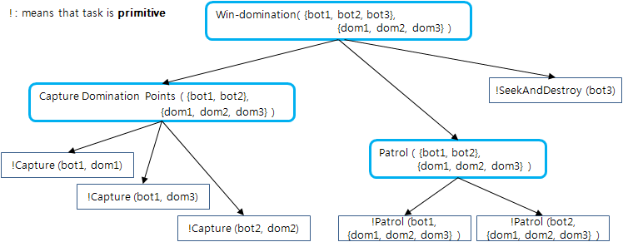
Example
http://sweeper.egloos.com/m/2641419

Slide 8
World State
Like GOAP we still need to monitor world state
This tracks whether can perform tasks
Tracks what effect the task will have
Like GOAP, choice of representation is vital
Can be Boolean
Or something that can evaluate to Boolean
E.g. health > 100
May also be struct with multiple components e.g. weapon type
As the planner will make changes
Usual to make working copy of world state data structure

Slide 9
Preconditions And Effects
In order for an task, whether high level or primitive, to be considered in a plan it must satisfy preconditions
Each task has a list of preconditions associated with it
These are checked against world state
Therefore must have same representation
An action will also have effects
These are changes to the world state made by an task
E.g. distance to enemy changes
May affect precondition of another task
Therefore affects evolution of plan

Slide 10
Example
Primitive attack task with preconditions and effects
AttackTask(agent a, enemy e, weapon w)
Preconditions[hasweapon(a, w), Distance(a.position, e.position) < w.range, isInSightof(a, e)]
AttackAction(a, e, w) // operator
Effects(isDead(e) == true, w.ammo -= 1)
This task tests to see if we have a weapon, we are in weapon range and can see our enemy
The effect of the task is to kill the enemy (it’s a big weapon) and reduce the ammo

Slide 11
High Level Task Example
Defeat_Enemy(agent a, enemy e)
Method 1 [hasWeapon == true, isNear(e) == true]
[Attack(a, e, weapon)]
Method 2 [hasWeapon == true, isNear(e) == false]
[GoTo(a, e), Attack(a, e, weapon)]
Method 3 [hasWeapon == false, isNear(e) == false]
[GetWeapon(a), GoTo(a, e), Attack(a, e, weapon)]
This is a high level task with three methods
Method 1 is the highest priority, it will be tried first
If it’s preconditions cannot be satisfied-
Method 2 will be investigated
Otherwise method 3 will be tried
If none of the methods can be performed, this part of the plan will fail

Slide 12
Backtracking
If one branch of the plan fails
The planner backtracks up the tree
And looks for an alternative plan
Without exploring the failed branch any further
This is the secret of the improved performance
If the entire plan fails, then some sensible default action can be performed
Like running away for example

Slide 13
The Plan
If a path through the tree is successful
The primitive tasks are added to an action list
If a path through the tree satisfies the final goal state
E.g. the enemy is dead
The action list is returned as the final plan
This can then be used by the AI agent
If no plan which reaches the goal state can be found
Return an empty plan

Slide 14
Pseudocode For The Planner
plan(goal state)
if working world state == goal state
return action list
take first branch of tree
if primitive task
if preconditions satisfied
add task to action list
update working world state with effects
else
return fail
else
for each method
if preconditions satisfied
return plan(goal state)

Slide 15
Advantages And Disadvantages
Pros
Faster than GOAP
More controllable
Trees are hand designed
More expressive than GOAP
Complex plans can be described
Cons
Planners still performance intensive
Hand design of tree can lead to design errors
Complex to design tree

Slide 16
Last Notes
Some debate about planners in general
Often difficult to implement
Performance costs
Benefits not always obvious
Tend to be better for large open worlds
Many possible situations for AI to deal with
Hard to predict player actions makes scripting a problem
In small constrained game world
Simpler AI e.g. state machines or behaviour trees are better

